Slide 1
OPTICs (Ordering Points To Identify the ClusteR Structure)
CLUSTERING aLGORITHM

Slide 2
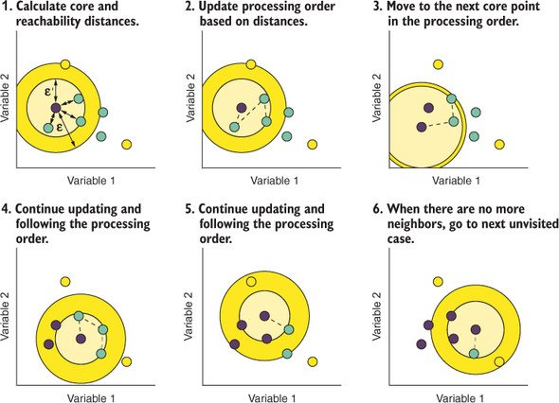
Similar to DBSCAN but works better with varying densities AND sHAPES.

Slide 3
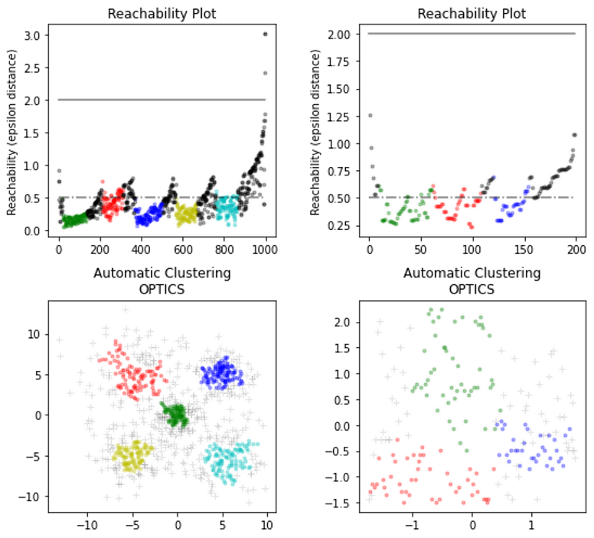
How it WorkS ?
Orders data points based on their density connectivity and generates a reachability plot to visualize clustering structure.

Slide 4
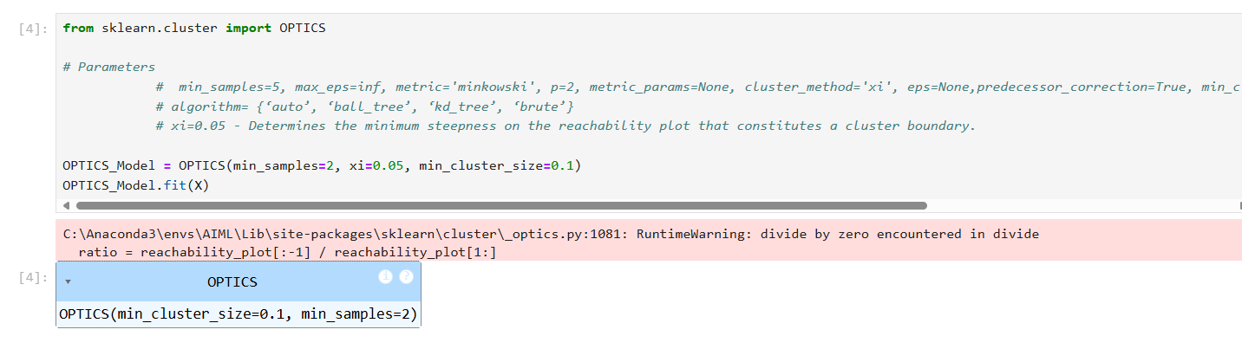
Model Creation

Slide 5
- Priyadharshini Manikandan

